Slide 1
AI-Driven solution for Identity & Access Management
~ Birir Sospeter

Slide 2
Agenda
2
Introduction
The Quantum Computing Threat
Current Identity Management Challenges
AI-driven Solution for Identity Management
Adaptive Learning
Pattern Recognition
Anomaly Detection
Viability and potential Downside of AI Integration
Case Study Analysis
Proactive and thoughtful strategy
Conclusion

Slide 3
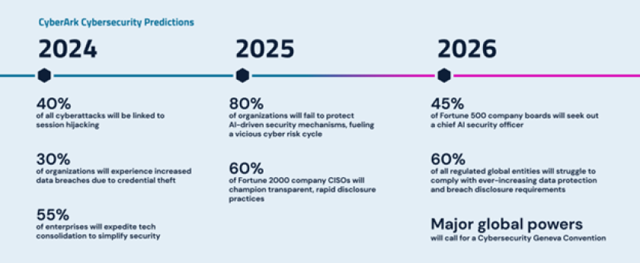
Introduction
The rapidly changing landscape of cybersecurity and quantum computing presents unprecedented challenges for traditional identity management techniques. Quantum computing poses significant risks to current cryptographic systems, potentially undermining their security. Our study proposes a novel approach that strengthens identity management systems against quantum threats by leveraging artificial intelligence (AI). Utilizing AI capabilities like adaptive learning, pattern recognition, and anomaly detection, our solution proactively safeguards digital identities. We explore the feasibility and potential drawbacks of this integration, emphasizing its transformative impact in mitigating quantum computing risks and ensuring resilient identity management in a volatile cyberspace.

Slide 4
Research Problem Statement
Problem:
Despite advancements in cybersecurity, current identity and access management systems face increasing vulnerabilities from emerging quantum computing threats.
Objective:
To develop quantum-resistant strategies that enhance the security and resilience of identity and access management systems against quantum-based attacks.
Significance:
Addressing this challenge is crucial for safeguarding sensitive data and maintaining trust in digital ecosystems amidst the impending era of quantum computing.

Slide 5
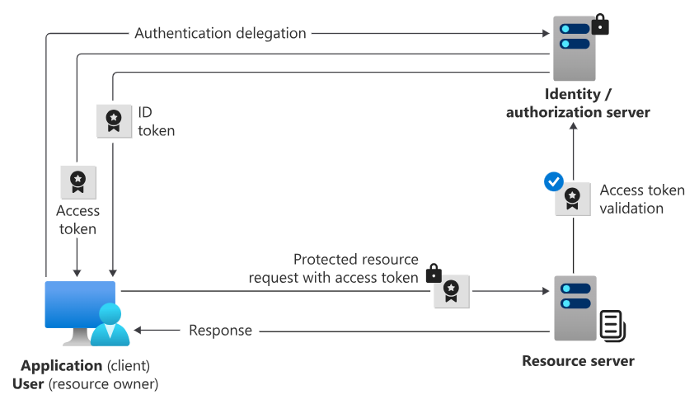
Identity & Access Management
The user (resource owner) initiates an authentication request with the identity provider/authorization server from the client application.
If the credentials are valid, the identity provider/authorization server first sends an ID token containing information about the user back to the client application.
The identity provider/authorization server also obtains end-user consent and grants the client application authorization to access the protected resource. Authorization is provided in an access token, which is also sent back to the client application.
The access token is attached to subsequent requests made to the protected resource server from the client application.
The identity provider/authorization server validates the access token. If successful the request for protected resources is granted, and a response is sent back to the client application.

Slide 6
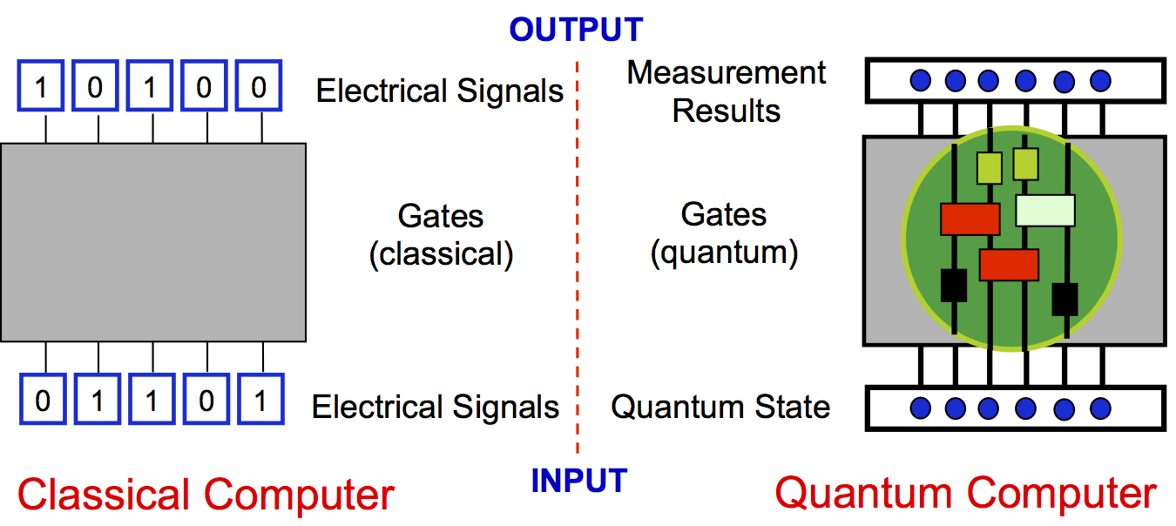
The Quantum Computing Threat
Vulnerabilities in Existing Systems
Traditional cryptographic algorithms, such as RSA and ECC (Elliptic Curve Cryptography), which underpin most identity management systems, rely on the difficulty of factorizing large numbers or solving discrete logarithms. Quantum computers, particularly through Shor's algorithm, can solve these problems exponentially faster than classical computers, rendering these cryptographic methods vulnerable. This vulnerability means that encrypted data, secure communications, and authentication processes that depend on these algorithms could be compromised.
Proposed Solution
Adaptive Learning:
AI can continuously learn and adapt to new threat patterns, ensuring that identity management systems stay ahead of quantum-enabled attacks.
Pattern Recognition: AI algorithms can detect unusual patterns or behaviors that might indicate a quantum-based attack, allowing for real-time response and mitigation.
Anomaly Detection: AI can identify anomalies in user behavior or system operations, flagging potential breaches before they escalate.

Slide 7
Current Identity Management Challenges
7
Scalability & Complexity: Managing an increasing number of identities in hybrid environments.
Security Threats: Credential theft through phishing/social engineering and insider threats.
Compliance: Meeting data privacy laws (GDPR, CCPA) and maintaining audit trails.
User Experience: Balancing security with usability; managing Single Sign-On (SSO) risks.
Interoperability: Integrating legacy systems with modern IAM solutions.
Emerging Technologies: Managing access for cloud services, IoT, and mobile devices.
Quantum Computing: Quantum threats to cryptographic algorithms (RSA, ECC), necessitate quantum-safe cryptography.

Slide 8
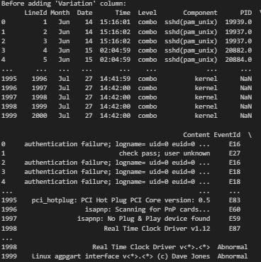
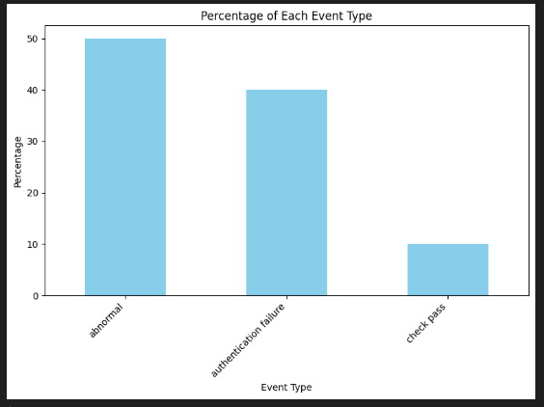
Windows Log-data Processing
Windows Event Log Utilization in AI-Driven IAM
Anomaly Detection
Identifies patterns in log data that deviate from the norm.Detects unusual login attempts, unauthorized access, etc.
Pattern Recognition
Recognizes recurring sequences/behaviors in log data. Trains AI models on historical data for typical user behaviors.
Adaptive Learning
Continuously improves detection by learning from new data. Updates models to enhance accuracy and reduce false positives.
Dataset Division
CheckPass: Successful authentication logs for normal behavior analysis.
Abnormal: Irregular activities like unusual login times for closer scrutiny.
FailedAuth: Failed authentication attempts to identify potential breaches.

Slide 9
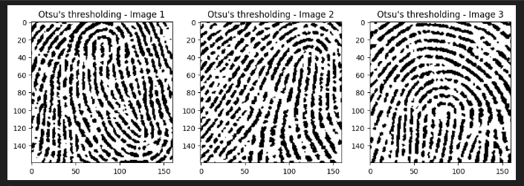
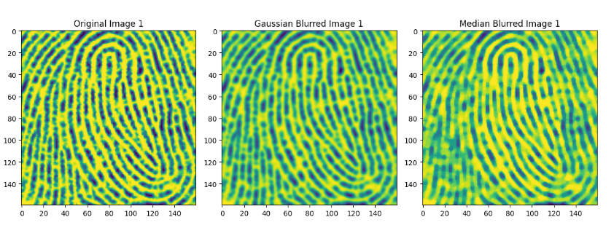
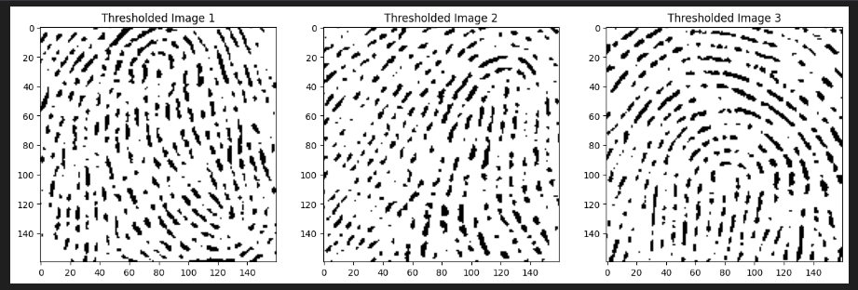
Fingerprint Data Processing
Data Acquisition
We got fingerprint images dataset.
Ensures high-quality images for accurate processing.
Preprocessing
Enhances image quality through noise reduction and contrast adjustment.
Aligns and standardizes images for consistency.
Feature Extraction
Identifies unique fingerprint patterns such as ridges, valleys, and minutiae points.
Converts these features into a digital template.
Template Matching
Compares the extracted template with stored templates in the database.
Uses algorithms to measure similarity and determine identity.
Anomaly Detection
Monitors for irregular patterns that may indicate spoofing or tampering attempts.
Alerts administrators to potential security threats.
Adaptive Learning
Continuously updates the system with new fingerprint data to improve accuracy.
Adapts to changes in user fingerprints over time.

Slide 10

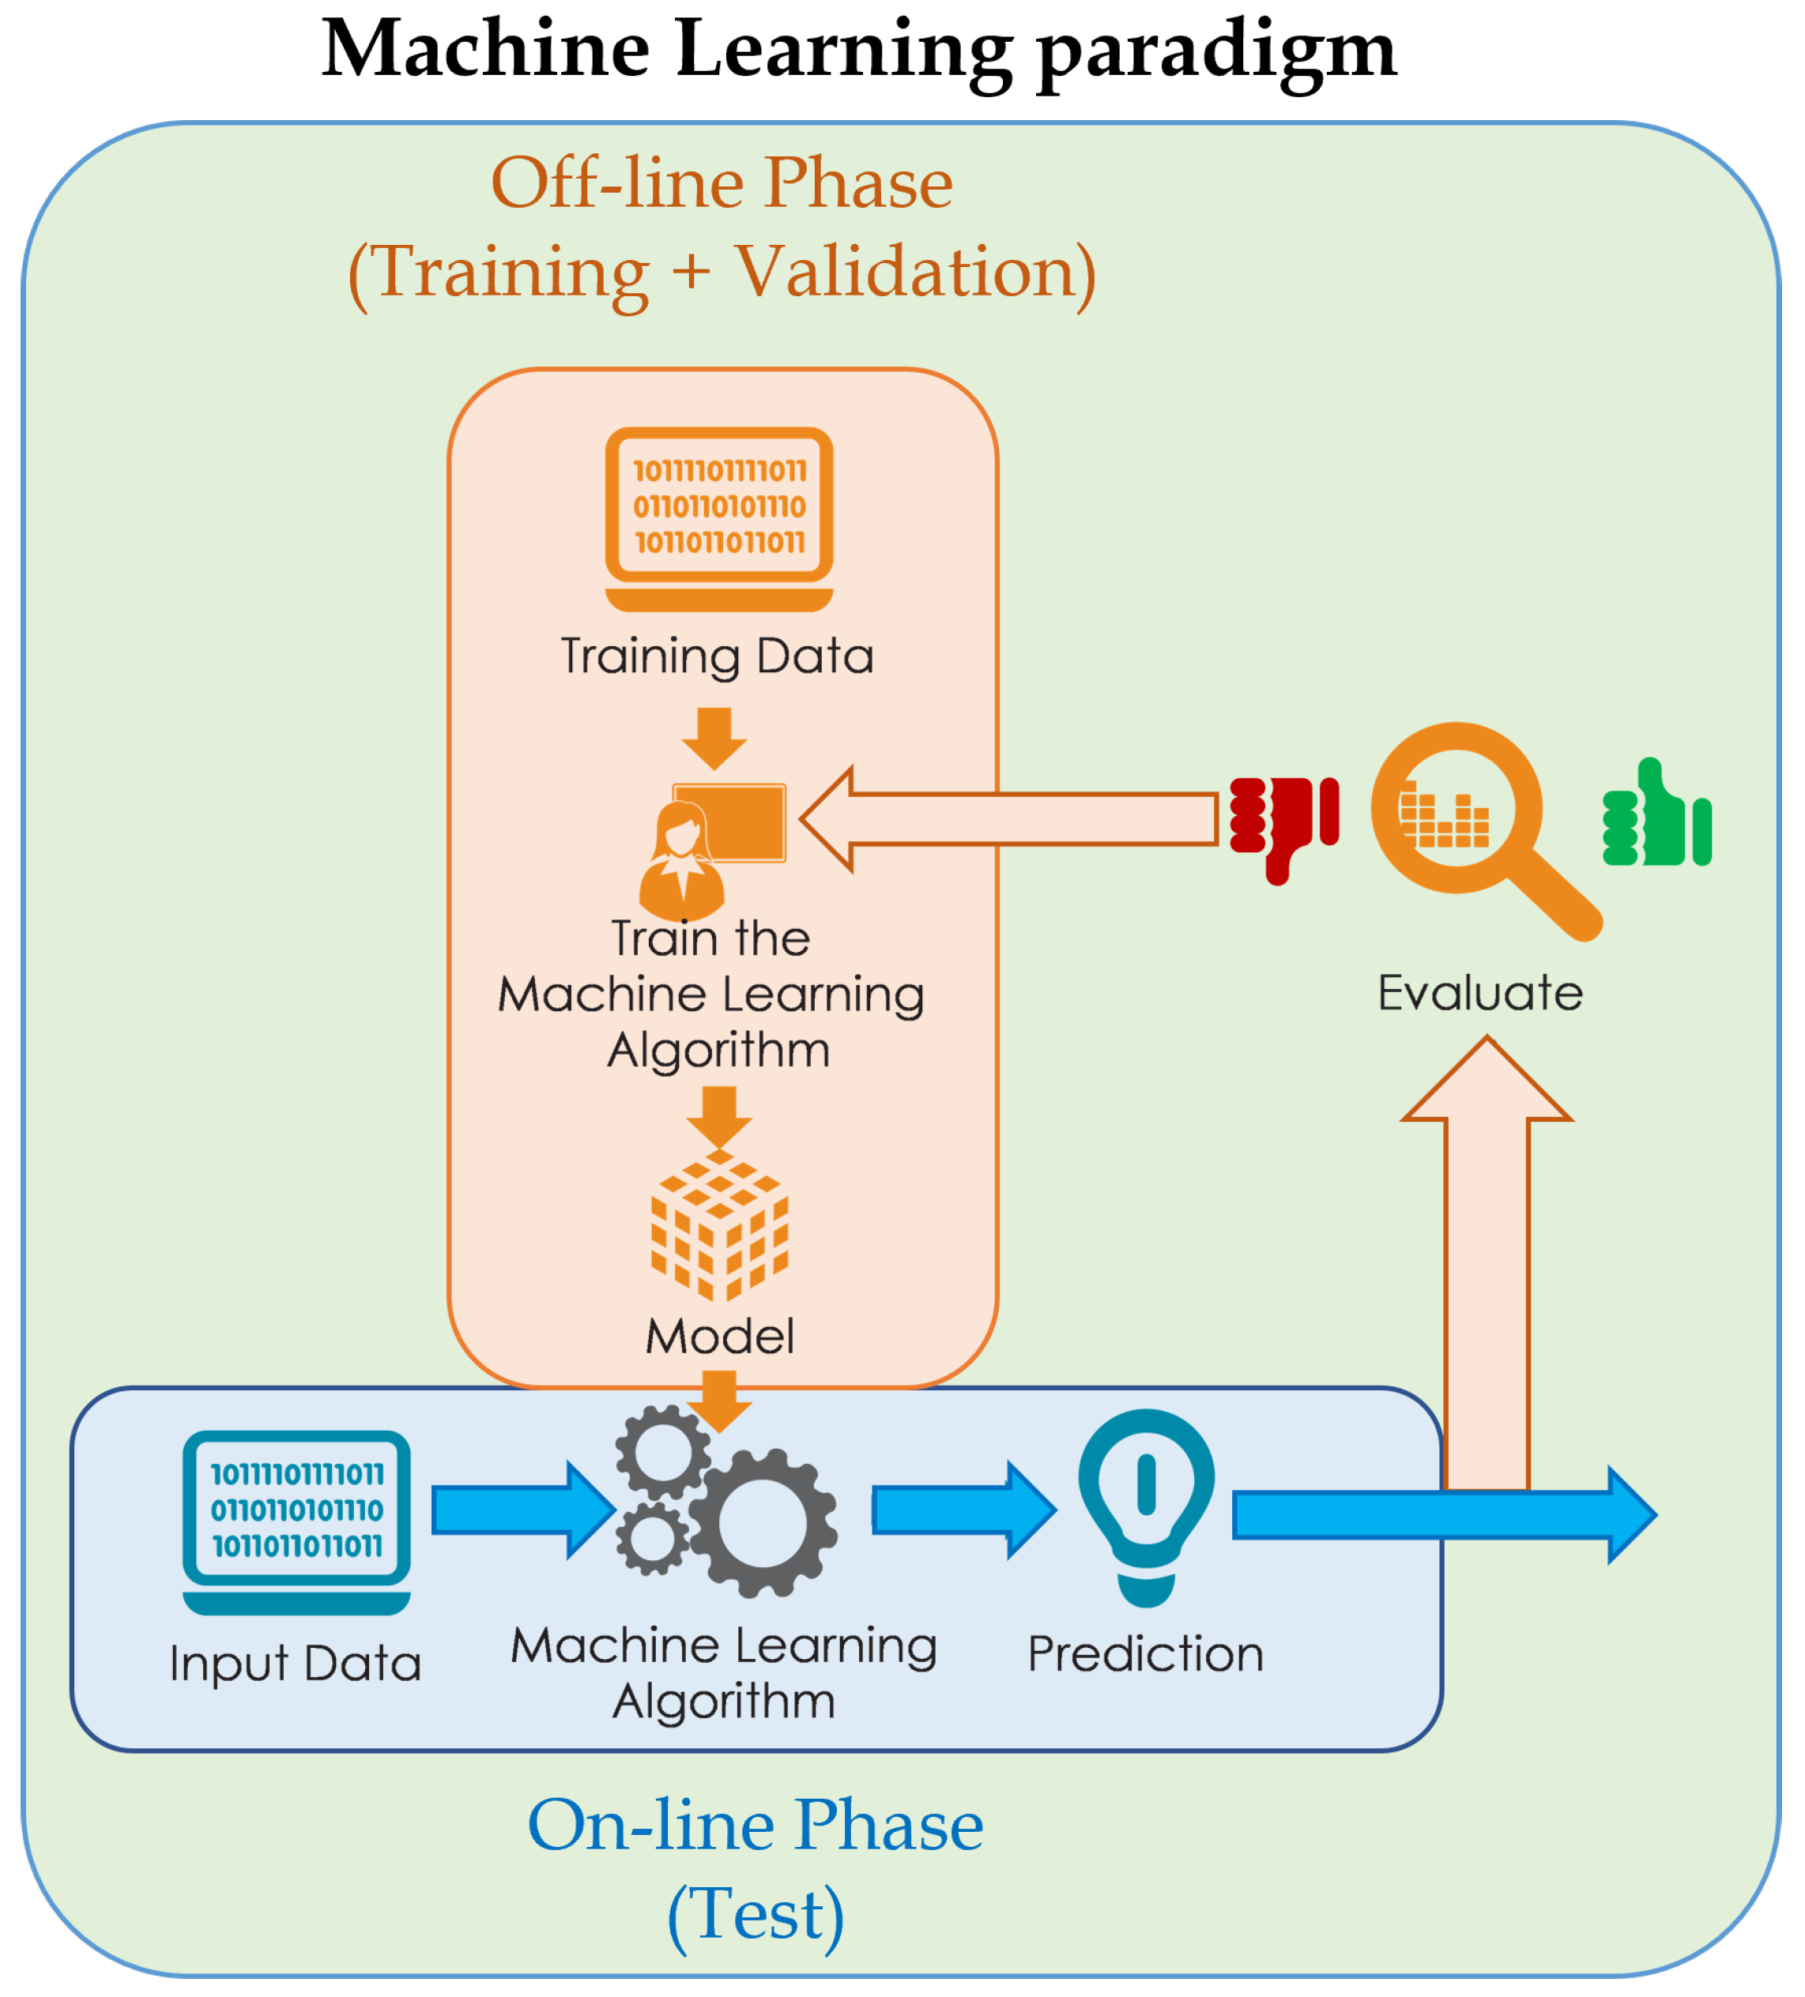
AI-Driven Solutions for Identity Management
Adaptive Learning Application: By analyzing fingerprint data and Windows log data, our AI models continuously learn from the patterns of legitimate user behavior. Outcome: This adaptive learning capability enabled the IAM system to quickly identify and adapt to new threat patterns, ensuring that the system remained resilient against evolving attacks.
Pattern Recognition Context: Recognizes patterns in fingerprint authentication and Windows log data. Application: By examining the fingerprint data, the AI can establish typical user access patterns. Similarly, it can analyze Windows log data to recognize standard user behaviors, identifying deviations that may indicate potential security threats.
Anomaly Detection Context: Detects anomalies in the fingerprint authentication process and Windows log data. Application: Anomalies such as unusual login times, locations, or access to sensitive data can be flagged. If a fingerprint scan shows irregularities or if Windows log data indicates atypical access patterns, the system can prompt further verification or initiate a security response.

Slide 11
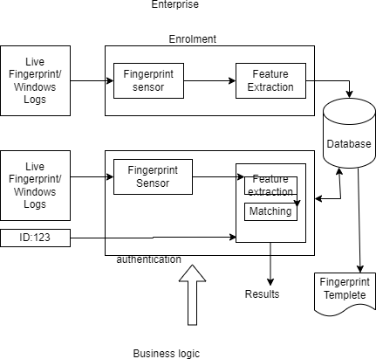
Adaptive Learning
Continuous Data Collection Fingerprint Data:
Collection data from each fingerprint scan to build a comprehensive profile of authorized users.
Windows Log Data: Monitors and records user activities, login attempts, access times, and other relevant events.
Real-Time Analysis Fingerprint Patterns:
Analyzes the minutiae points (specific features) in fingerprint scans to detect any changes or anomalies.
User Behavior: Uses Windows log data to establish baseline behaviors for each user, identifying deviations that might indicate unauthorized access.
Dynamic Updating Threat Detection:
Continuously updates the AI models with new fingerprint data and user behavior patterns to recognize emerging threats.Adaptation: Adjusts security protocols based on the latest data, ensuring that the system remains resilient against both known and unknown threats.

Slide 12
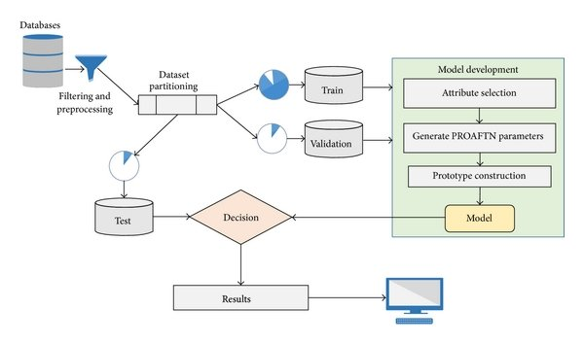
Pattern Recognition
Context:
Increases the precision of identity verification by recognizing detailed patterns in biometric and behavioral data.
Application: Reduces false positives and negatives by ensuring that only genuine deviations from established patterns prompt security actions.
User Behavior Insights Context: Provides insights into user behavior, helping to identify normal and abnormal patterns.
Application: Enhances the ability to differentiate between legitimate and suspicious activities, improving overall security posture.

Slide 13
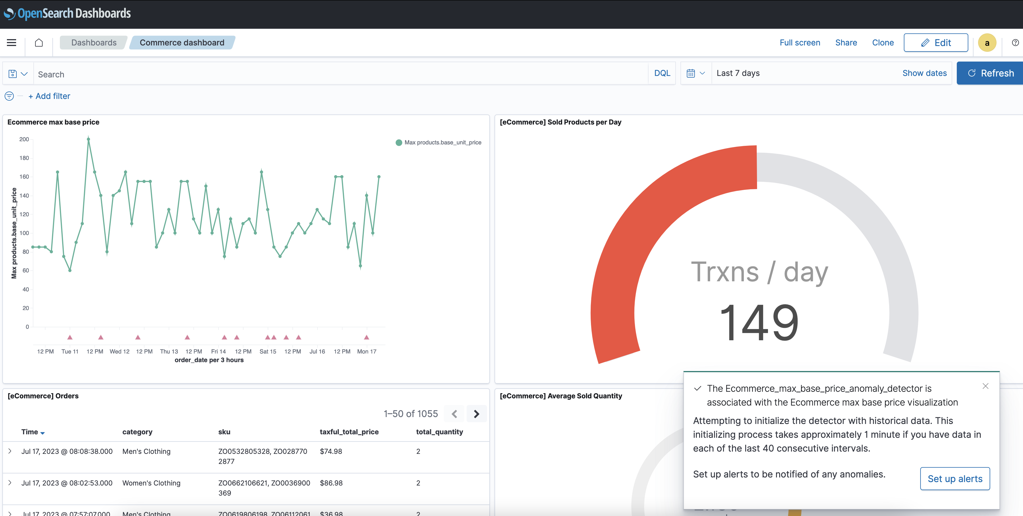

Anomaly Detection
Early Threat Detection Context:
Utilizes anomaly detection to identify potential security threats based on fingerprint and Windows log data.
Application:
Detecting abnormal login attempts or unusual access patterns can trigger immediate security responses to prevent unauthorized access.
Reduced False Positives Context:
Improves accuracy by minimizing false alerts through precise anomaly detection.
Application: Ensures that security measures are activated only in response to genuine threats, enhancing operational efficiency. Adaptive Security Measures Context: Adjusts security protocols dynamically based on detected anomalies. Application: Enables proactive responses to emerging threats, maintaining robust protection against evolving cybersecurity risks.

Slide 14
Viability and Potential Downsides of AI Integration
Viability:
AI enhances efficiency and automates processes.
Improves decision-making with data-driven insights.
Enables personalized user experiences.
Potential Downsides:
Dependency on data quality and availability.
Ethical concerns: bias, privacy, and transparency.
Displacement of jobs and societal impact.

Slide 15
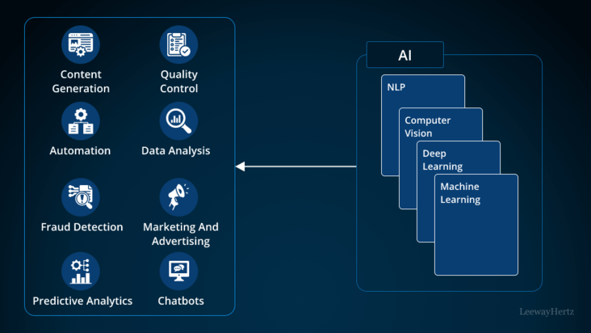
Case Study Analysis
Real-world examples where AI-driven identity management systems have made a tangible impact:
Darktrace: Darktrace employs AI for cybersecurity through its Enterprise Immune System technology. It uses machine learning algorithms to detect and respond to cyber threats in real-time, autonomously defending against sophisticated attacks.FireEye: FireEye integrates AI and machine learning into its cybersecurity platforms to enhance threat detection and response capabilities. Their Helix Security Operations Platform leverages AI to analyze and correlate data across the network, identifying potential threats and anomalies.Symantec (now NortonLifeLock): Symantec utilizes AI-powered security solutions to protect against malware, ransomware, and other cyber threats. Their Endpoint Protection and Norton 360 products employ AI to provide proactive defense and threat intelligence.

Slide 16

Proactive and Thoughtful Strategy
Anticipation:
Foreseeing challenges and opportunities.
Strategizing with foresight and precision.
Implementing plans effectively and adaptively.
Importance:
Risk Mitigation: Minimizing potential risks through preparedness.
Opportunity Maximization: Seizing opportunities with agility and insight.
Long-term Vision:
Aligning actions with overarching goals and values.

Slide 17
Conclusion
In conclusion, adopting a proactive and thoughtful strategy is not merely about planning for the future—it's about shaping it. By anticipating challenges, seizing opportunities, and aligning actions with long-term goals, we pave the way for sustainable growth, resilience, and meaningful impact. Let's commit to embracing proactive and thoughtful approaches in all our endeavors, ensuring we navigate complexity with clarity and purpose.

Slide 18
Thank You
Birir Sospeter Kipchirchir
+254 701-616-456
sospeterbirir1@gmail.com
https://birir-portfolio.Netlify.app

